Slide 1
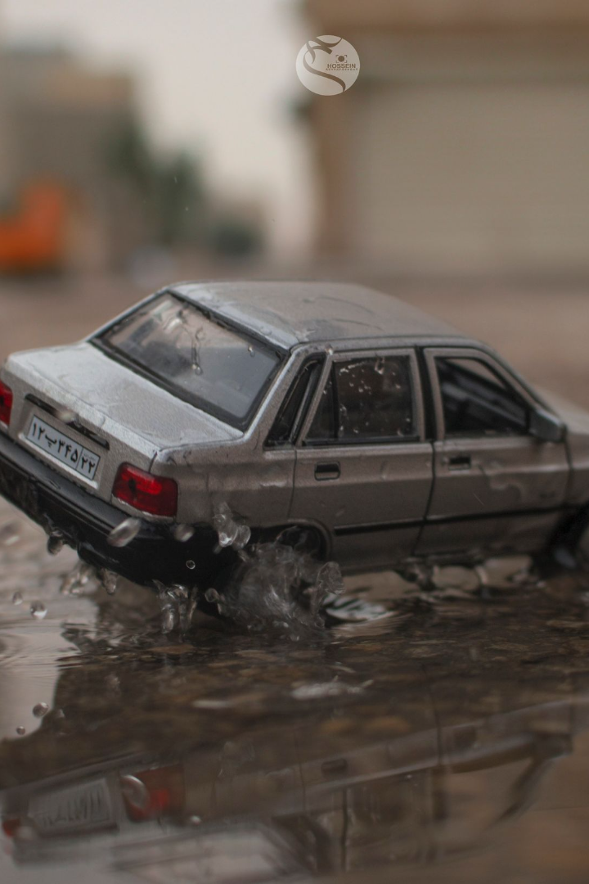
Product : PuddleSense
"Imagine having a personal road companion that not only captures the journey but also empowers you with real-time road insights. Introducing 'PuddleSense' , the daily road-scanning camera designed to keep you safe, informed, and ahead of the curve."

Slide 2

Identifying the Problem Statement
1
Unsafe Road Conditions in Rainy Weather
2
Lack of Real-Time Road Information
Rainy weather creates hazardous road conditions, endangering drivers.
Drivers lack real-time road condition data, leading to unexpected challenges.
3
Limited Awareness of Safe Routes
Drivers are unaware of safe routes during rainy seasons.

Slide 3
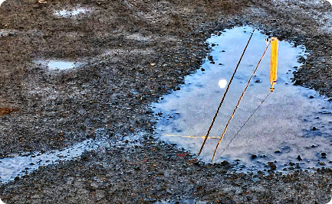

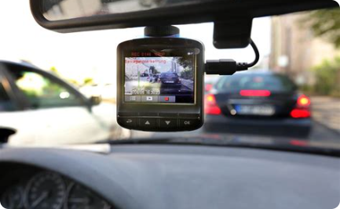
An Innovative Solution Overview
Daily Road Scanning:
Real-time Puddle Alerts:
Safe and Easy Installation:
PuddleSense scans the roads daily, creating a comprehensive database of road conditions.
Get instant alerts about puddle-prone areas during rainy weather.
Mounts easily on your car's windshield for hassle-free use.

Slide 4

Product or Service:
PuddleSense redefines the driving experience by addressing the persistent challenges posed by wet and unpredictable road conditions. Our state-of-the-art system scans the roads daily, offering drivers a vital edge with real-time environmental insights. Say goodbye to the uncertainty of puddle-prone areas and the hazards of rainy weather. PuddleSense stands as a dependable co-pilot, providing immediate alerts on puddles and guiding drivers on the safest routes. It's more than just a camera; it's your assurance for secure and confident travel, regardless of the weather outside."

Slide 5
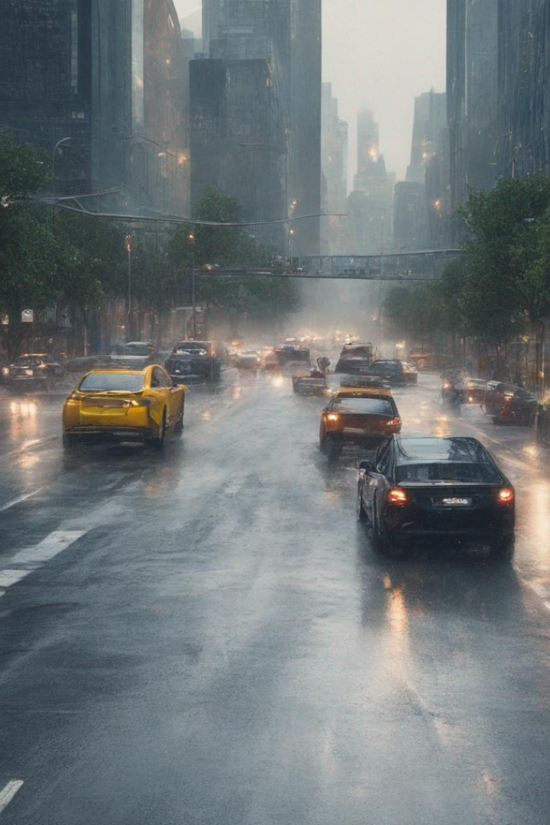
Targeted Audience
Commute and Daily Drivers: Individuals who commute to work, travel regularly, or drive daily and are looking for enhanced safety and convenience during their journeys.
Rainy Season Navigators: Drivers living in regions with frequent rain and inclement weather conditions, who face specific challenges during these periods.
Fleet Managers: Professionals responsible for managing vehicle fleets, who aim to improve driver safety, reduce maintenance costs, and ensure on-time deliveries, especially in challenging weather.

Slide 6

Conclusion:
"With 'PuddleSense,' you're not just driving; you're experiencing the road like never before. Say goodbye to unexpected puddles and hello to a safer, smarter way to travel. Don't just go, go with 'PuddleSense.'"

Slide 7
Team Members
Anubhav Rawat (RA2311050010057)
Drishti Lund (RA2311047010163)
Prakrut Dave (RA2311003010056)

